Slide 1
Cause And Effect Diagram
By Harsh Joshi
IT-2k19-18

Slide 2
What is a Cause and Effect Diagram?
A cause and effect diagram examines why something happened or might happen by organizing potential causes into smaller categories. It can also be useful for showing relationships between contributing factors.

Slide 3
History of cause and effect diagram
The cause and effect diagram was invented by professor Kaoru Ishikawa of Tokyo university, a highly regarded Japanese expert in quality management.
He first used it in 1943 to help explain to a group of engineers at Kawasaki steel works, how a complex set of factors could be related to help understand a problem.
The cause and effect diagram are also often called as Ishikawa diagram, after their inventor or Fishbone diagram because the diagram itself looks like the skeleton of a fish.

Slide 4
Why to use cause and effect diagram?
Need to study a problem/issue to determine the root cause.
Want to study all the possible reason why a process is beginning to have difficulties, problem, or breakdowns.
Need to identify areas for data collection.

Slide 5
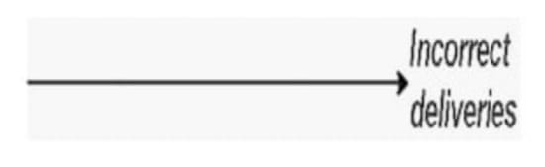
How to draw cause and effect diagram?
Step 1 :- To begin making a cause and effect diagram, write the main issue or problem to be analyzed in a box that is typically on the right edge of the page, halfway down the drawing area or page. A line called the "spine" or "backbone" should extend to the left starting from the edge of the main box.

Slide 6
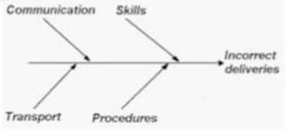
Step 2 :- Identify all the broad areas of enquiry in which the cause and effect diagram being investigated may lie and angle branches off of the spine, each representing a cause or effect of the main issue.

Slide 7
In the manufacturing industry, these are referred to as the 6Ms:
Methods. Are there well-written and appropriate training guidelines in place? Are certain policies or regulations causing slow-downs or creating unnecessary steps?
Machines. Are there any maintenance issues with the tools used or the number of tools available?
Materials. Are there any issues getting raw materials from suppliers? Any problems with transportation (timing) or with the quality of the supplies?

Slide 8
Measurements. Could there be errors in calculation or contamination that caused false readings? Could the way you measure be inconsistent in some way? Is your equipment regularly calibrated and maintained?
Mother Nature/Environment. Is there too much moisture in the environment? Are temperatures too hot or too cold? Is there excessive dust or other contamination?
Manpower/People. Do you have too little of your workforce devoted to a process? Are new people adequately trained? Is the training consistent? Are the right people with the right experience being hired or promoted? Is there a specific position creating a bottleneck or making frequent mistakes?

Slide 9
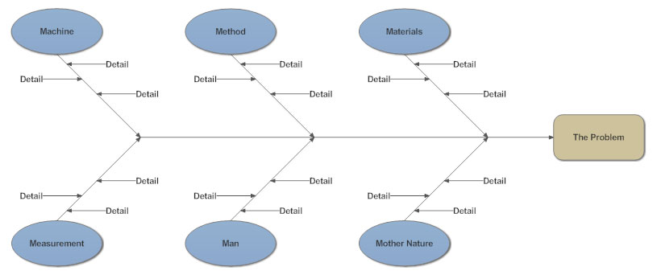
This is how the cause and effect look like after all this steps :

Slide 10
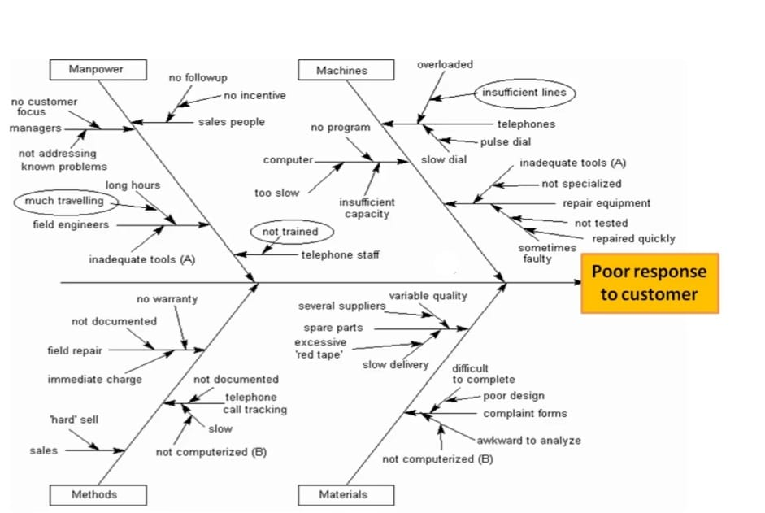
Example of cause and effect diagram:-

Slide 11
Benefits Of Cause and Effect Diagram :-
Identifies underlying causes :- The CE diagram is the best tool to use if you want to discover all potential causes for producing a certain effect.
Offers greater understanding :- The major notion behind the cause and effect diagram is to offer a better understanding of a certain problem though listing an inclusive list of potential causes.
Promotes teamwork :- The cause and effect diagram promotes group participation within the business, particularly during determining the problems or effects to be examined.
Cost effective :- Since the CE diagram aids on focusing only on the main causes of a certain issue, it ensures quick remedial actions are taken. Fast problem resolution saves money and prevents people from resorting to irrelevant discussions and complaints.

Slide 12
Best practice in cause and effect diagram analysis:
Identify the problem. Define the process or issue to be examined.
Brainstorm. Discuss all possible causes and group them into categories.
Draw the backbone. Once the topic is identified, draw a straight, horizontal line (this is called the spine or backbone) on the page, and on the right side, draw a rectangle at the end. Write a brief description of the problem in the rectangle.
Add causes and effects. Causes are added with lines branching off from the main backbone at an angle. Write the description of the cause at the end of the branch. These are usually one of the main categories discussed above. Details related to the cause or effect may be added as sub-categories branching off further from the main branch. Continue to add branches and a cause or effect until all factors have been documented. The end result should resemble a fish skeleton.
Analyze. Once the diagram has been completed, analyze the information as it has been organized in order to come to a solution and create action items.

Slide 13
Thank you

